Slide 1
Project management concepts and benefits
By
Sultana Rafique And Harsha Vardhan Reddy Yeruva

Slide 2
What is project management?
Project management can be defined as the discipline of applying specific processes and principles to initiate, plan, execute and manage the way that new initiatives or changes are implemented within an organization.
Key components of project management are:
Time – the intended duration of the work
Cost – the budget allocated for the work
Scope – what innovations or changes will be delivered by the project
Quality – the standard of the outcome of the project.

Slide 3
Project management stages
Although there are different project management methodologies and approaches, most projects follow these stages:
Initiating the project – the project manager defines what the project will achieve and realize, working with the project sponsor and stakeholders to agree deliverables.
Planning – the project manager records all the tasks and assigns deadlines for each as well as stating the relationships and dependencies between each activity.
Execution – the project manager builds the project team and also collects and allocates the resources and budget available to specific tasks.
Monitoring – the project manager oversees the progress of project work and updates the project plans to reflect actual performance.
Closing – the project manager ensures the outputs delivered by the project are accepted by the business and closes down the project team.

Slide 4
Types of Project Management
1. Waterfall Project Management
This is similar to traditional project management but includes the caveat that each task needs to be completed before the next one starts. Steps are linear and progress flows in one direction—like a waterfall
2. Agile Project Management
Agile project management is an iterative process focused on the continuous monitoring and improvement of deliverables.
3. Lean Project Management
This methodology is all about avoiding waste, both of time and of resources.

Slide 5
Benefits of project management
1. Clear, organized plans improve team collaboration
If you’ve ever leapt into a project without a plan, you know how messy things can get right from the start. You might end up skipping essential steps in your project schedule, scrambling to complete a forgotten task at the last minute, or answering the same logistical questions over and over again: “When’s this due? What are we doing next?” Worse, the quality of your work might suffer as you rush to push your project across the finish line.
2. Defining everyone’s role eliminates confusion
Once the prep work is done, it’s on to the actual management part of project management. However, without a clear project owner to help your team across the finish line, it’s all too easy for teammates to drop tasks, forget details, or not know who to go to with questions.

Slide 6
Benefits of project management
3. Well-defined goals improve team effectiveness
Projects aren’t successful when teams don’t know what their project goals are. Without clear goals, teams not only lack motivation—they also run the risk of working towards the wrong objective or toiling away at low-impact work.
4. Defining a communication plan keeps your team aligned and focused
Before you even get started on work, you should align on a communication plan. Your team likely has an email management tool, an instant messaging tool, and a project management tool, among others. A communication plan establishes when each tool should be used. For example, at Asana, team uses email for external communication, Slack for quick internal messages, and Asana for all of actionable work.
5. Project management tools help increase efficiency
To put these tips into action, consider using a project management tool to help team better collaborate and stay on track.

Slide 7
Project management key terms
1. WBS (Work Breakdown Structure)
2. Milestone
3. Stakeholder
4. Work Plan
5. Baseline
6. Triple Constraint
7. Project Life Cycle
8. Gantt Chart
9. Change Management
10. Risk Mitigation

Slide 8
Project management key terms
11. Activity
12. Assumptions
13. Business Case and Use Cases
14. Cost Estimation
15. Deliverable
16. Earned Value & Earned Value Management (EVM)
17. Project Change Request Form
18. SWOT Analysis
19. Three-Point Estimation
20. Project Management and Knowledge Area

Slide 9
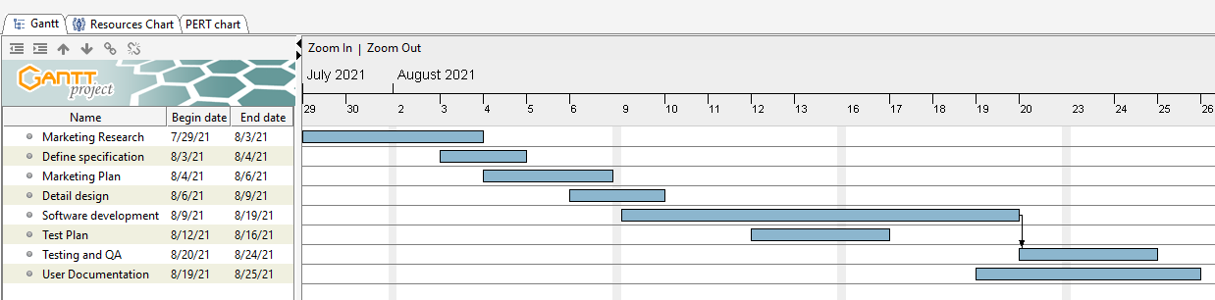
Example: Event Marketing Project Gantt Chart

Slide 10
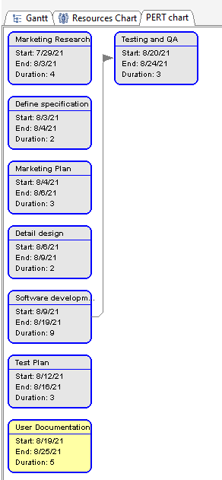
Event Marketing Project
PERT Chart:

